Slide 1
VLI – Excess Export Forecasting
DXC - Analytics Data Labs

Slide 2
Overview
SPRINT 1
SPRINT 2
SPRINT 3
Route Price Forecast
Excess Exportable Forecast
Allocation / Optimization

Slide 3
Production Forecasting

Slide 4
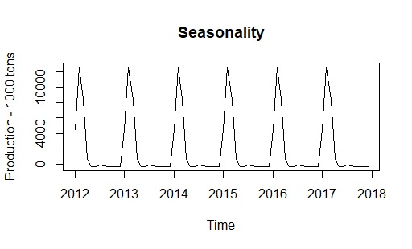
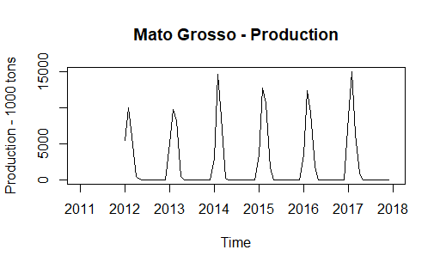
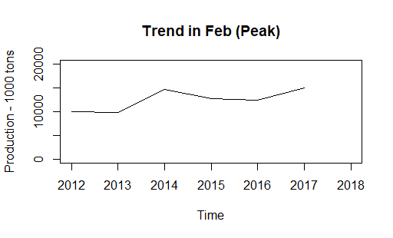
Forecasting Production

Slide 5
Data Sources
Data Significant for Model
Data Tested but Insignificant
Yuan vs USD Monthly
GDP Yearly, Inflation Monthly, Population State-wise
Fertilizer Prices of DAP, MOP Potash, Rock Phosphate, TSP, Urea (Monthly International Prices in USD per ton)
Export / Import:
Brazil Export and Import of Milho1&2, Soja (Monthly)
US Export of Milho1&2, Soja (Monthly / Yearly)
China Import of Soja
Argentina Export of Milho
CBOT International Prices of Soja and Milho
PRODUCTION
Macro-Economic Data
Soja
Milho1
Milho2
Year
State
Source: Agroconsult
Plantation Area
Real vs USD
Interest Rate Monthly
Soja and Milho International Prices
Source: Trading Economics
Macro-Economic Data
Harvest Area
Month
State
Weather Conditions
Source: Agroconsult
Rainfall, Temperature, Latitude, Longitude
Droughts, Floods, Hurricanes

Slide 6

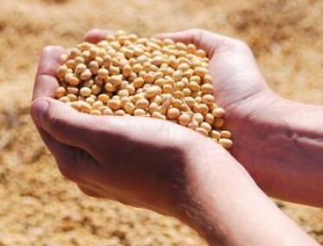
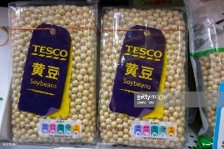



Modeling Approach
A.
B.
PRODUCTION
Plantation
Plantation
Productivity
Crop Price
Interest Rate
Real vs USD

Slide 7

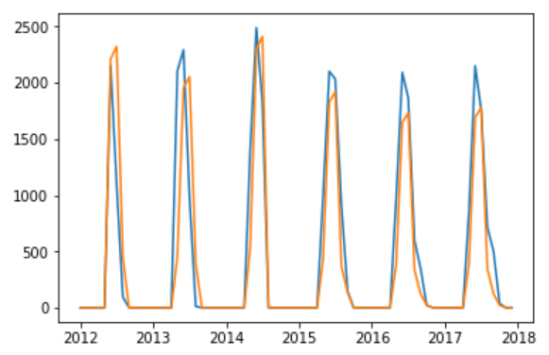
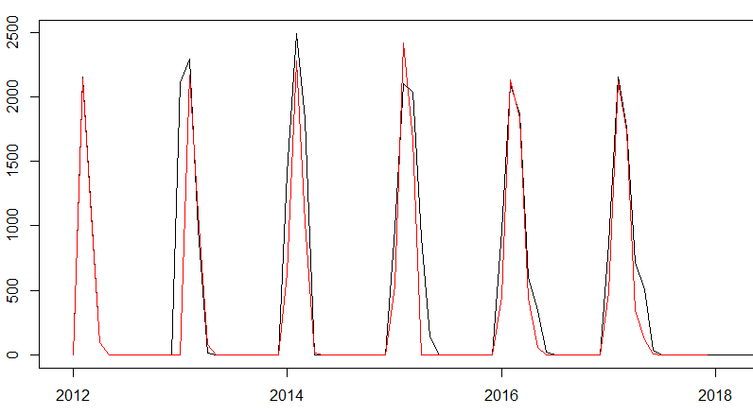
Models Tested for Production
1) Linear Regression
2) ARIMA (with Seasonality and External Variables)
1 Model for each crop = 3 Models Total
1 Model for each zone and crop = 25 Models Total
Production
Plantation
Year
Production
Plantation
Seasonal Differencing x 1
Month
FEATURES
Lag 1
Lag 2
Lag 3
Lag 4
Lag 12
Error Lag 12
Lag 3
Lag 11
Lag 12
Lag 13
Lag 5
State
Lag 4
Actual
Actual
Predicted
Predicted

Slide 8
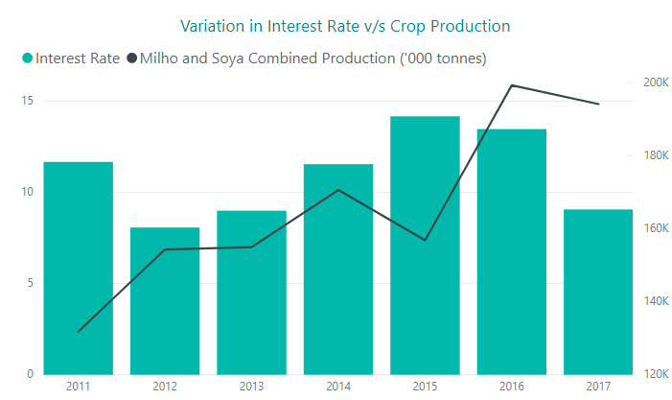
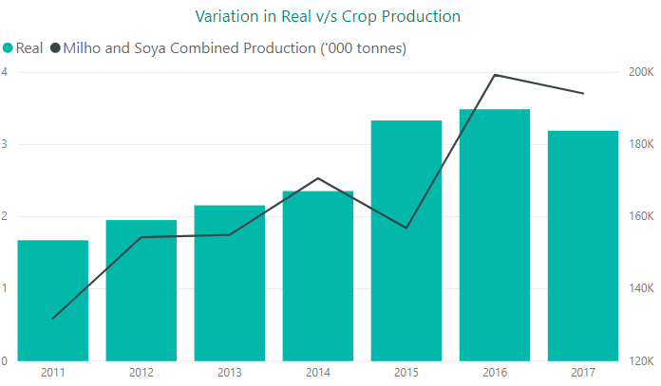
Model for Plantation
Plantation
Interest Rate vs Crop Production
(Negatively Correlated)
Exchange Rate vs Crop Production
(Positively Correlated)
Crop Price
Interest Rate
Real vs USD
Milho International Price – Lag1, Lag3
Soja International Price – Current, Lag3
Interest Rate for that Month
Exchange Rate for Month

Slide 9
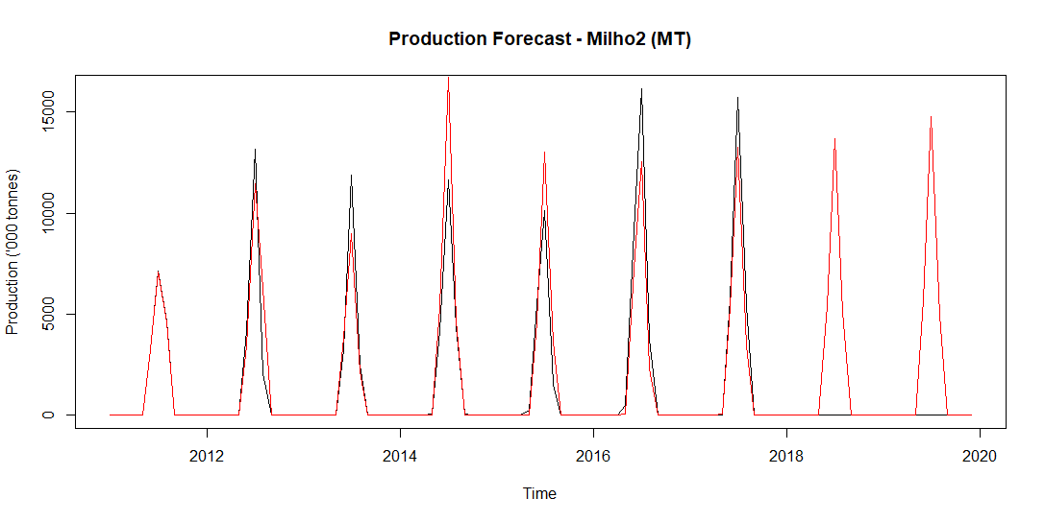
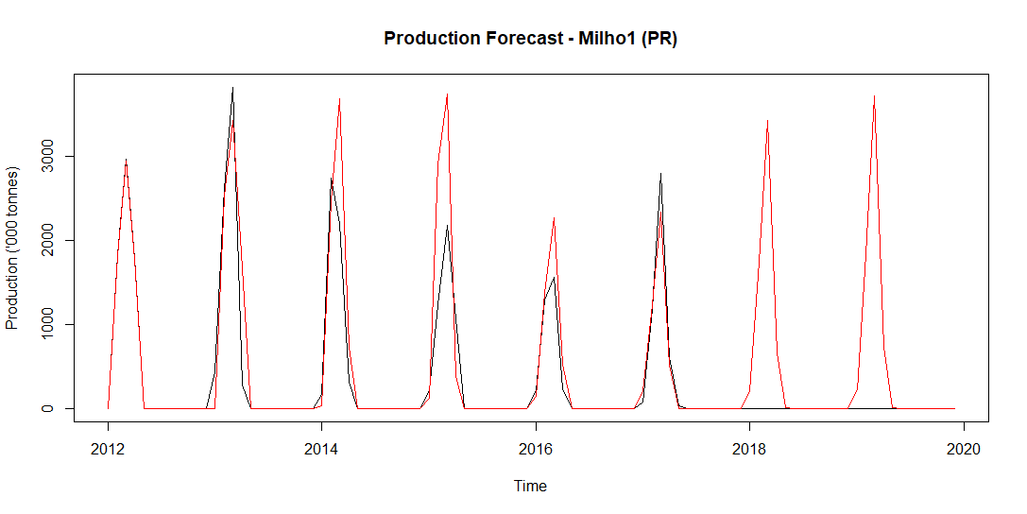
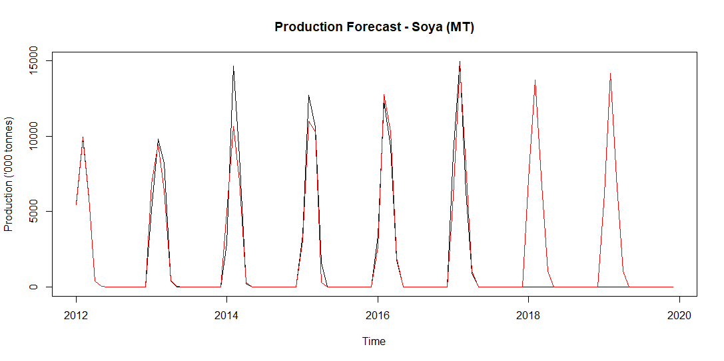
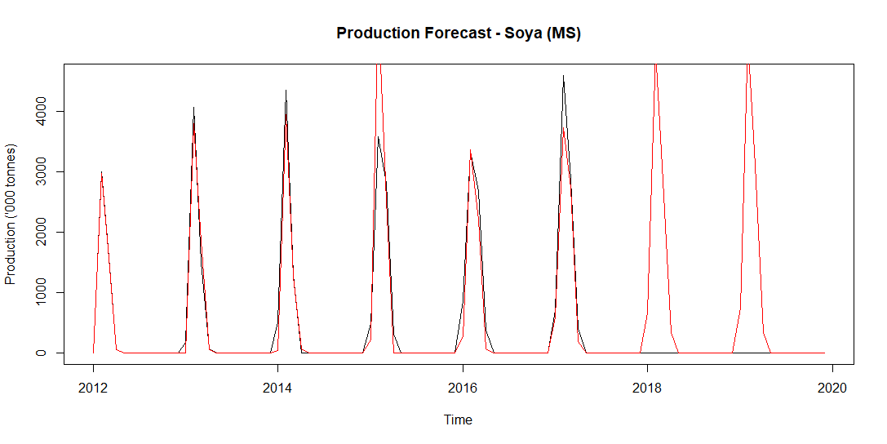
Results

Slide 10
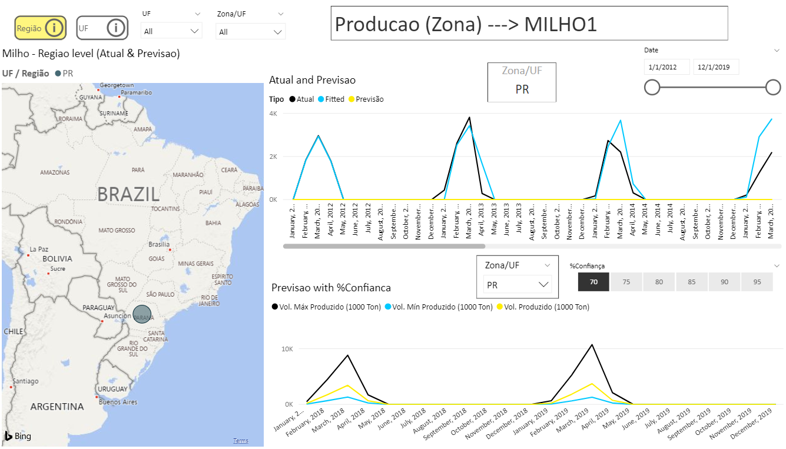

Slide 11
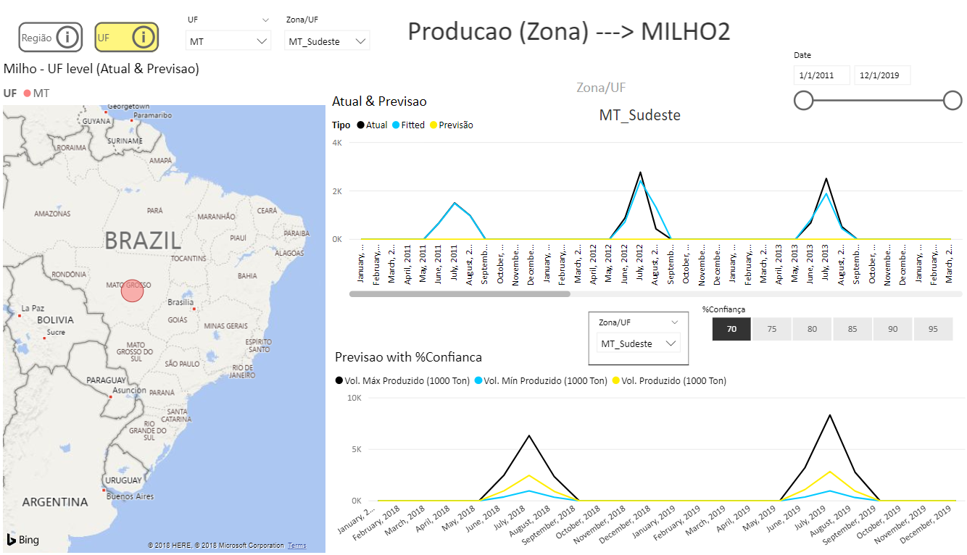

Slide 12
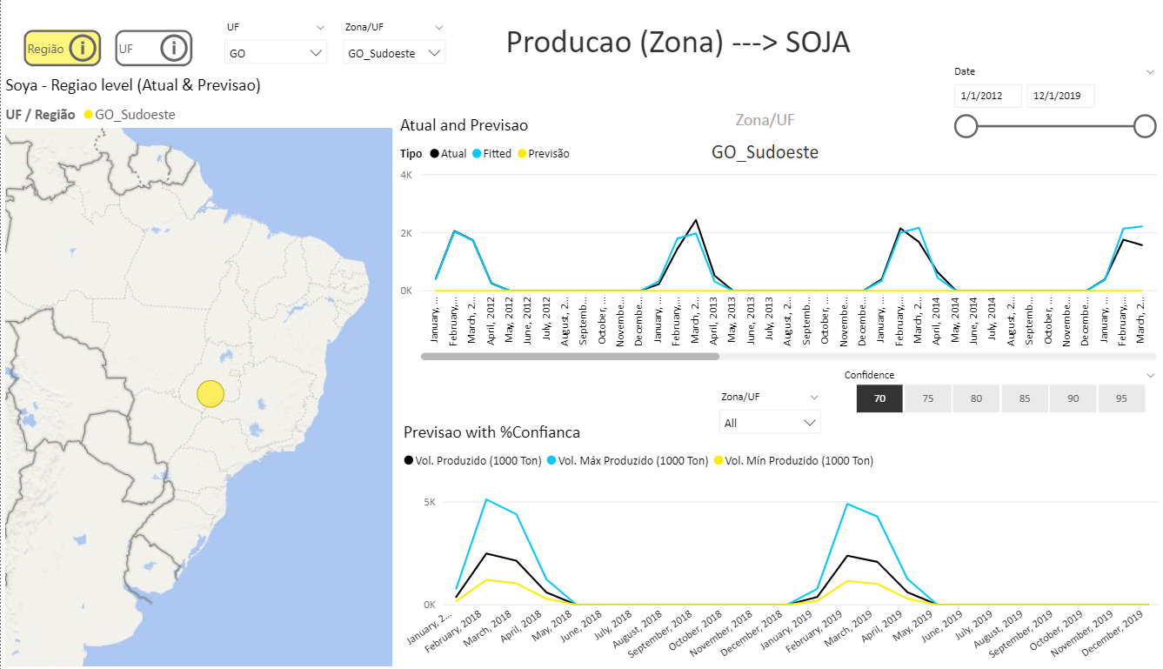

Slide 13
Export Forecasting

Slide 14
Modeling Approach
Approach & Solution:
We have used Agro Stat data considering exports values for different States of Brazil over 2011-2018 and using them to build models.
Time Series forecasting techniques ARIMAX (ARIMA + Seasonality + Co-Variates ) is used for modelling of Soya & Corn
We have built 13 models each for Soya and Corn
Model Building
Model Evaluation
Month | State | Actual Export (A) | Predicted Export (P) | Residuals (A-P)
January | MT | 3100 | 3000 | 100
February | MS | 1200 | 1500 | 300
March | GO | …… | …….. | ………..
Training Data (11-17)
SARIMA
Time Series Model
Monthly Data for different States of Brazil (2011-18)
Using Previous lags for future Predictions
Test Data (2018)

Slide 15
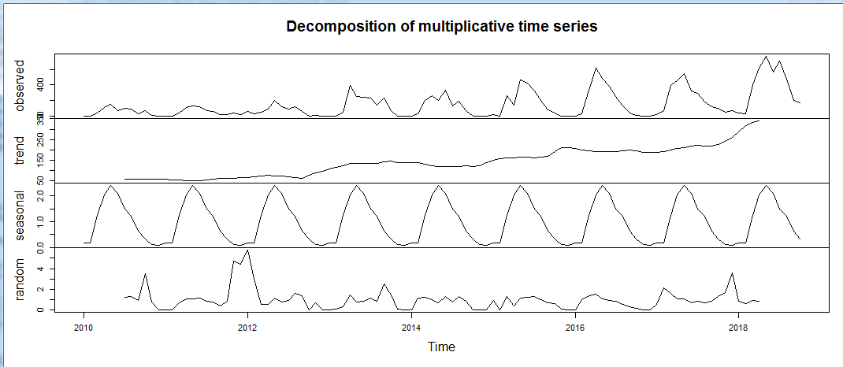
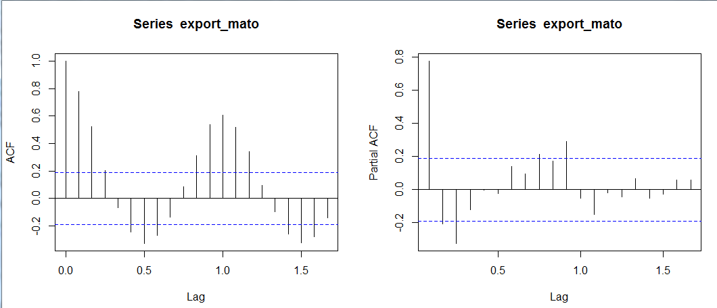
Data Sources
Economic Factors
Production Lags
ARIMAX
Brazil Exchange Rate w.r.t USD
China Exchange Rate w.r.t USD
Last 13 Months Production lags for Soya & Milho
Soja
Milho
Year
Month
State
Zone
Interest Rates
Inflation
Trend, Seasonality,
Co-variates
Brazil,& US – Soja and Milho Import and Exports
Price of Soja and Milho internationally
CBOT & Base Prices

Slide 16
Calculating zone values from state
Agrostat’s did not have zone wise export values, we have used agro consult's file to divide state export values into zones.
% distribution of each zone with respect to entire state and calculated the % export values.
State wise forecasting models and used these percentages to come up with zone-wise forecasting.

Slide 17
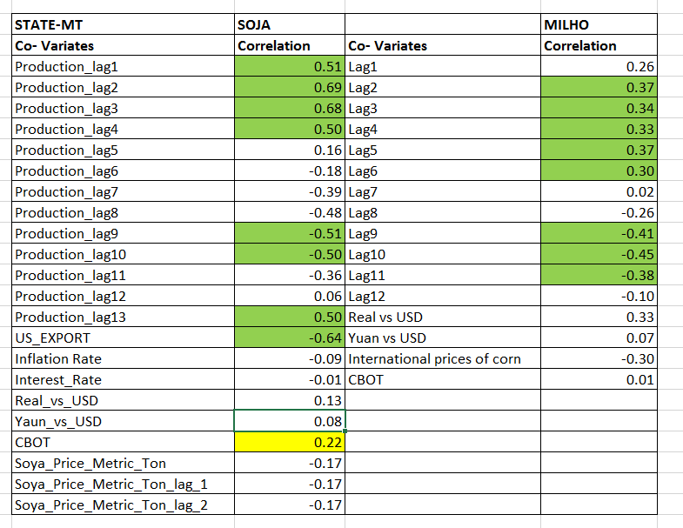
Co- Variates Correlations
Observations:
Exports value of soya and Corn for a given month has a high Correlations with the past Production value
Inflation Rate & Interest Rate has negative correlation with the exports values
US Export has high Negative Correlation with Brazil export
Exchange rate was not found significant for export
CBOT price has moderate correlation with soya and corn exports

Slide 18
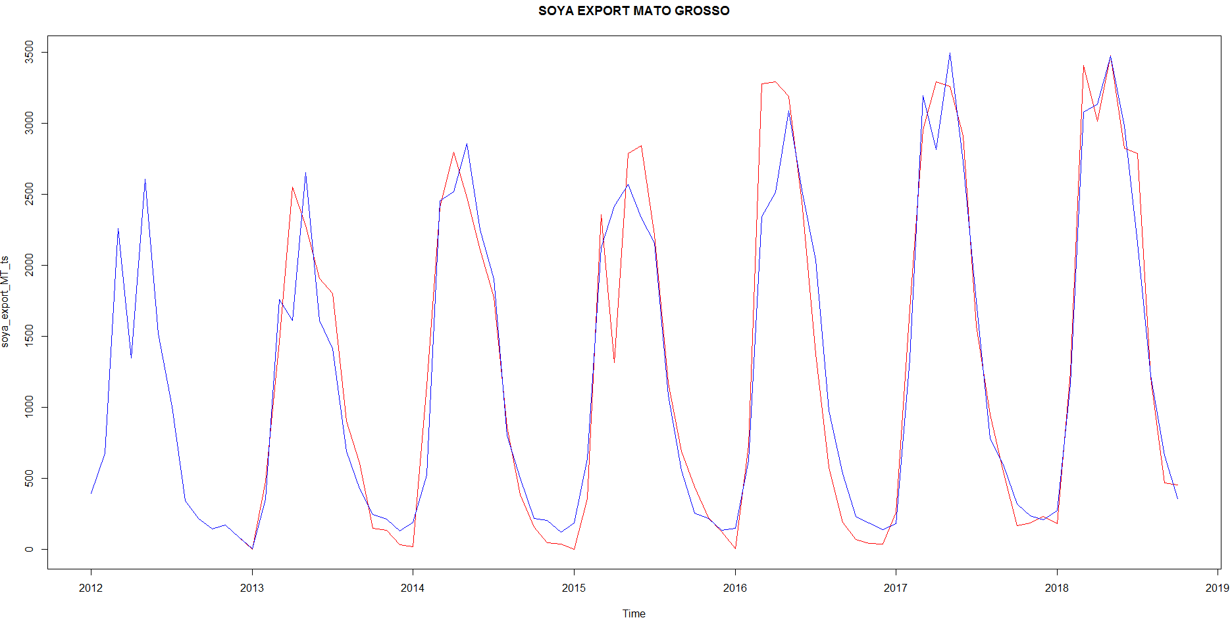
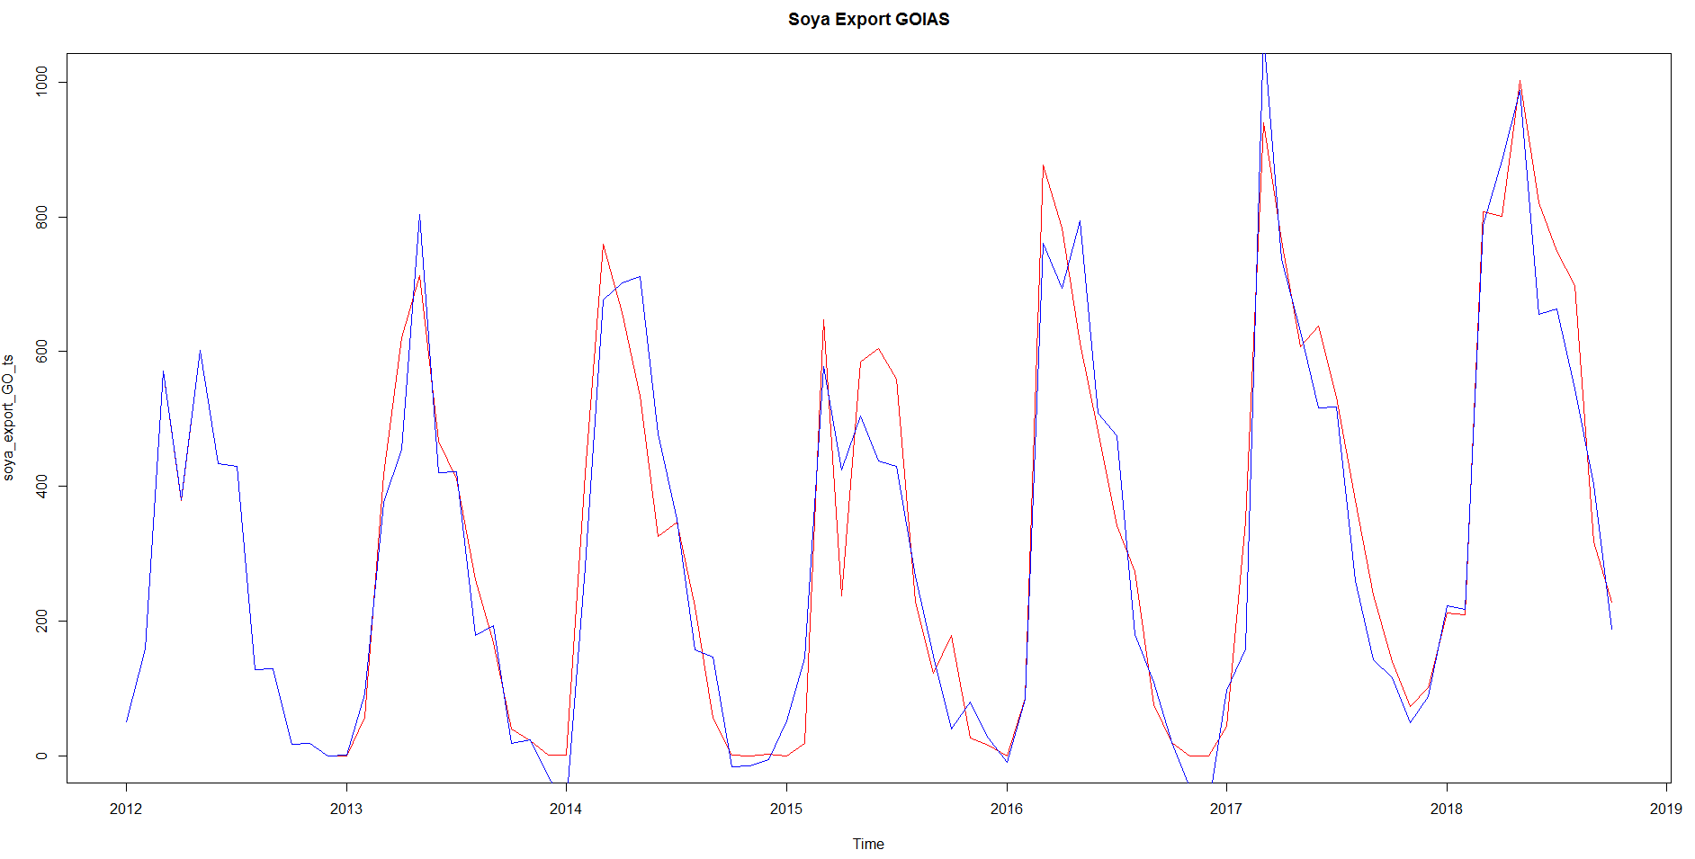
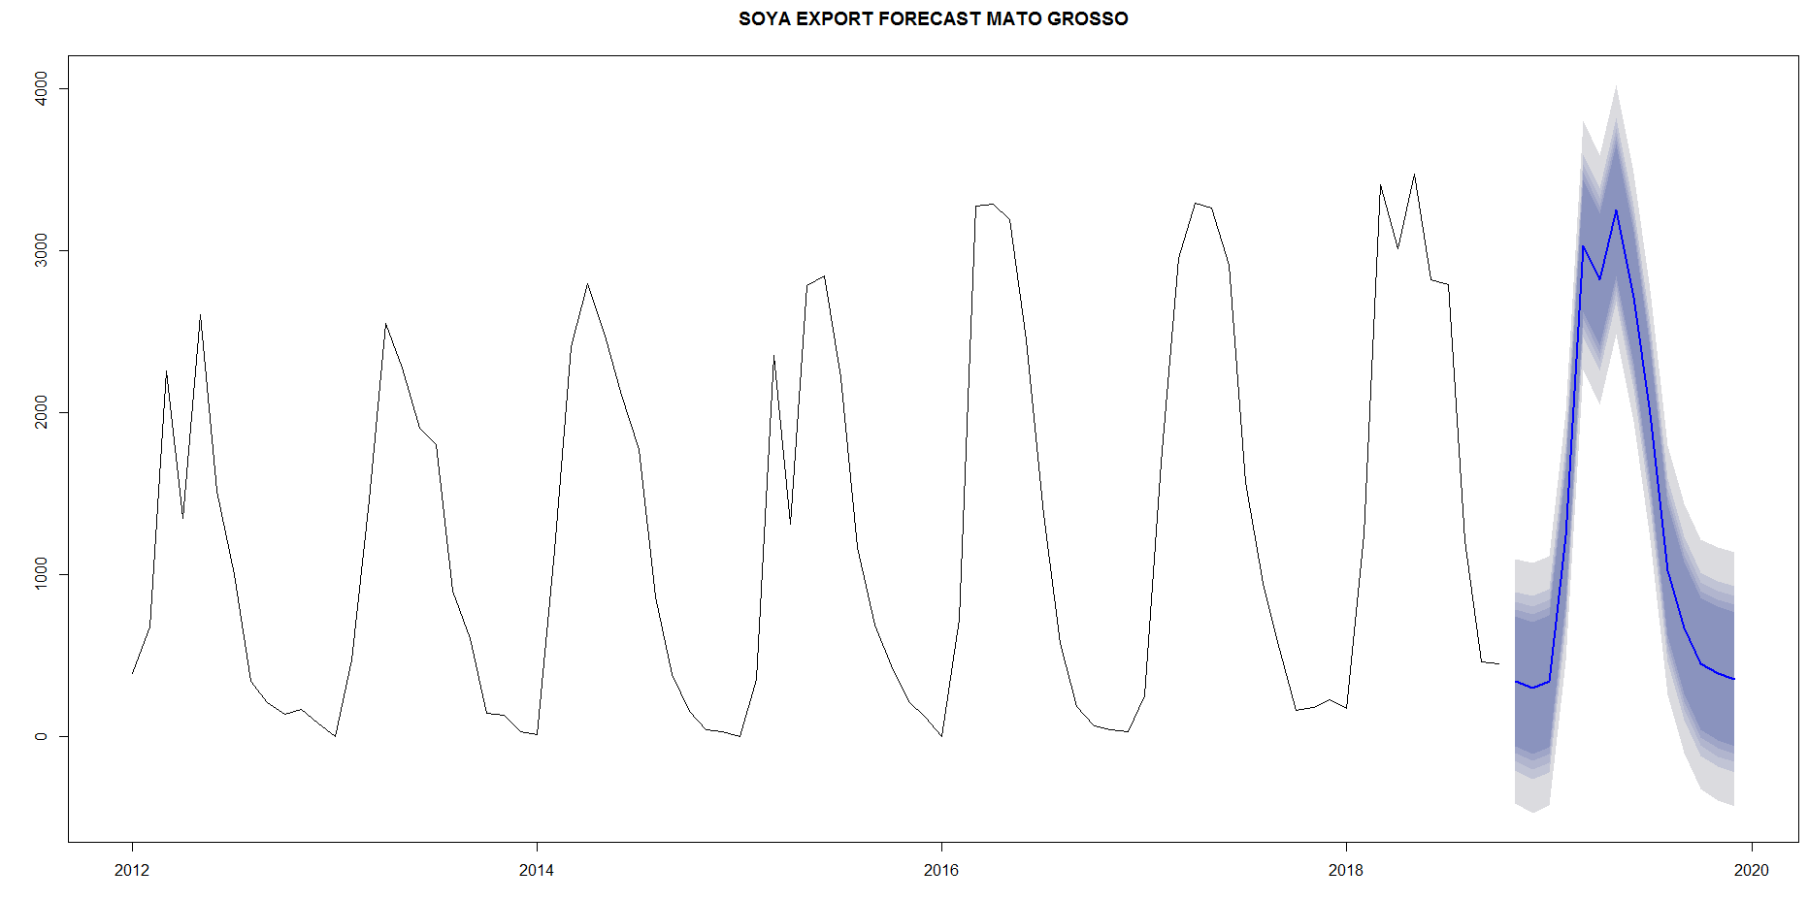
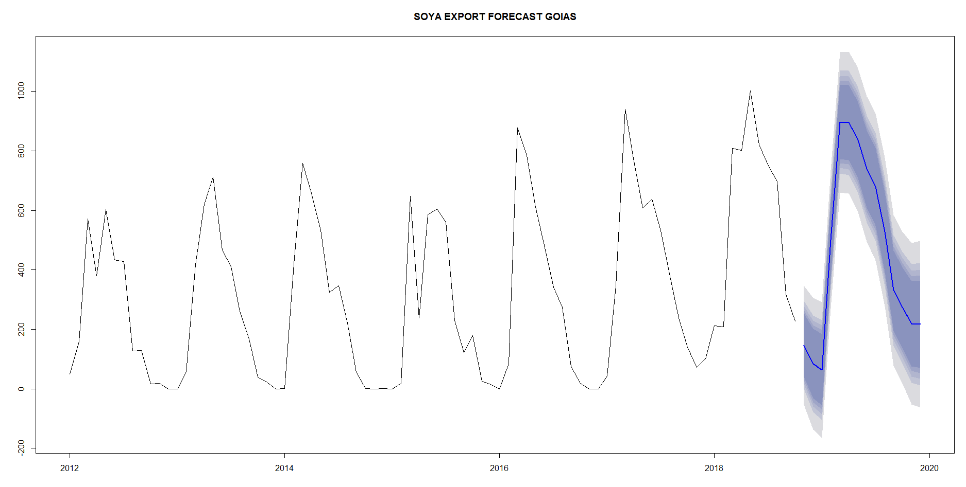
Results Soya
Mato Grasso
Goais
Red :Actual
Blue: Predicted

Slide 19
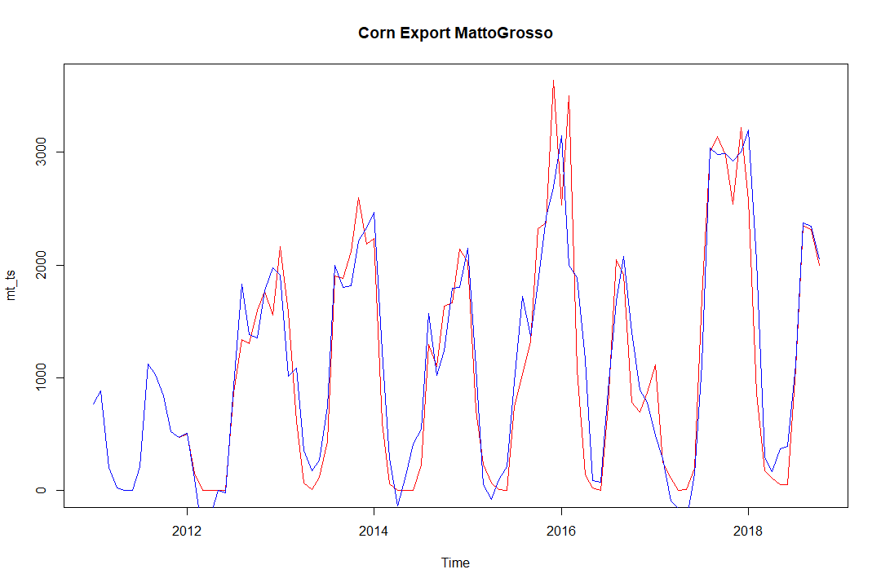
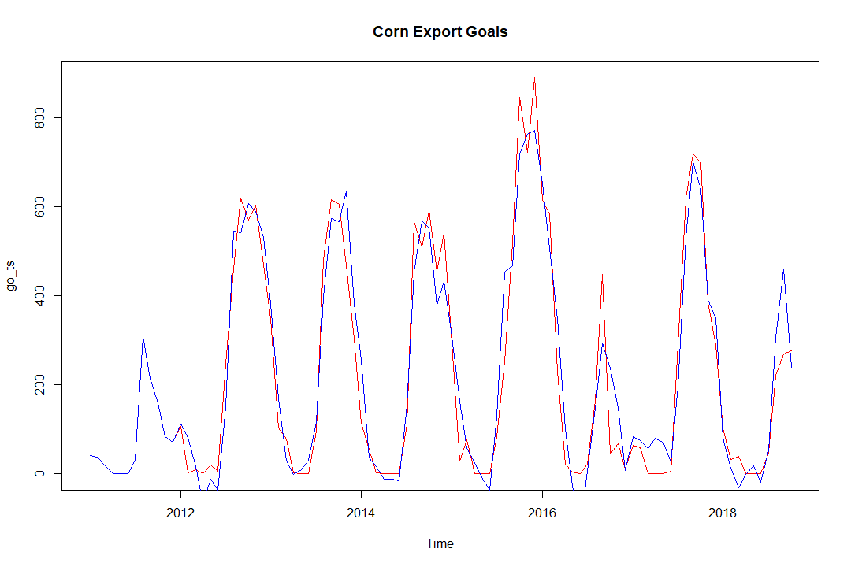
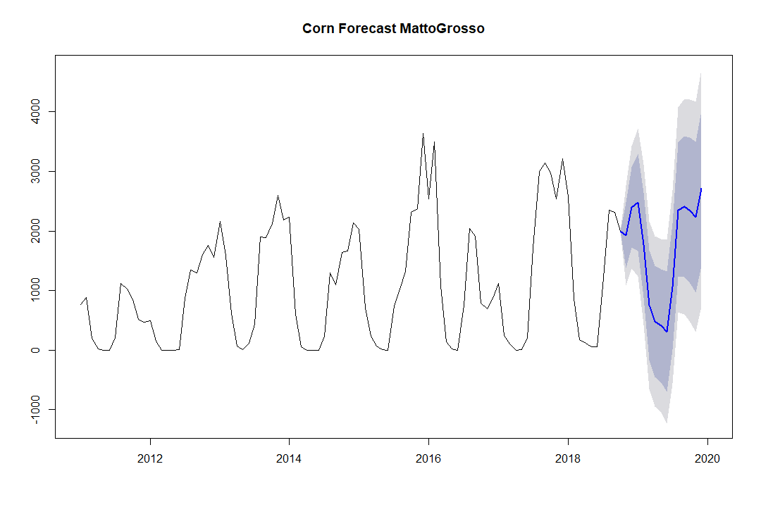
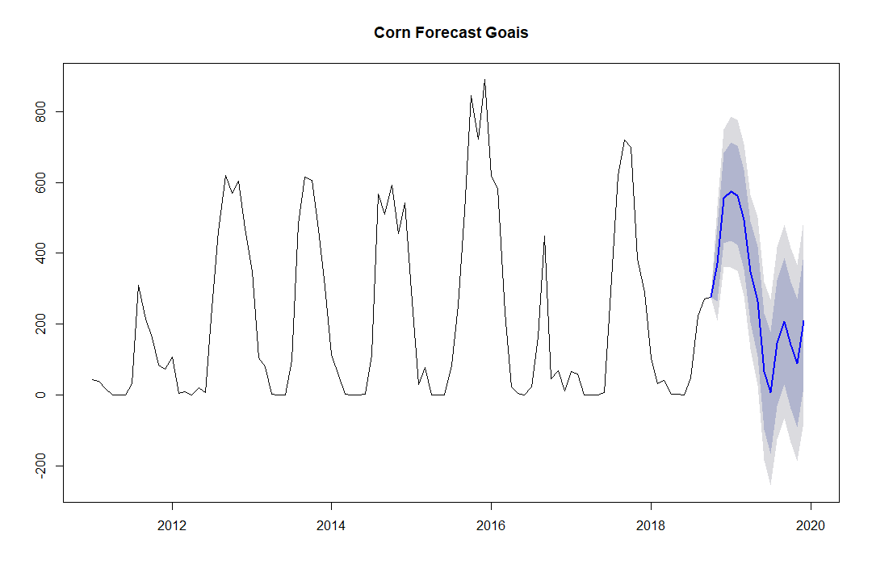
Results Corn
Mato Grasso
Goais
Red :Actual
Blue: Predicted

Slide 20
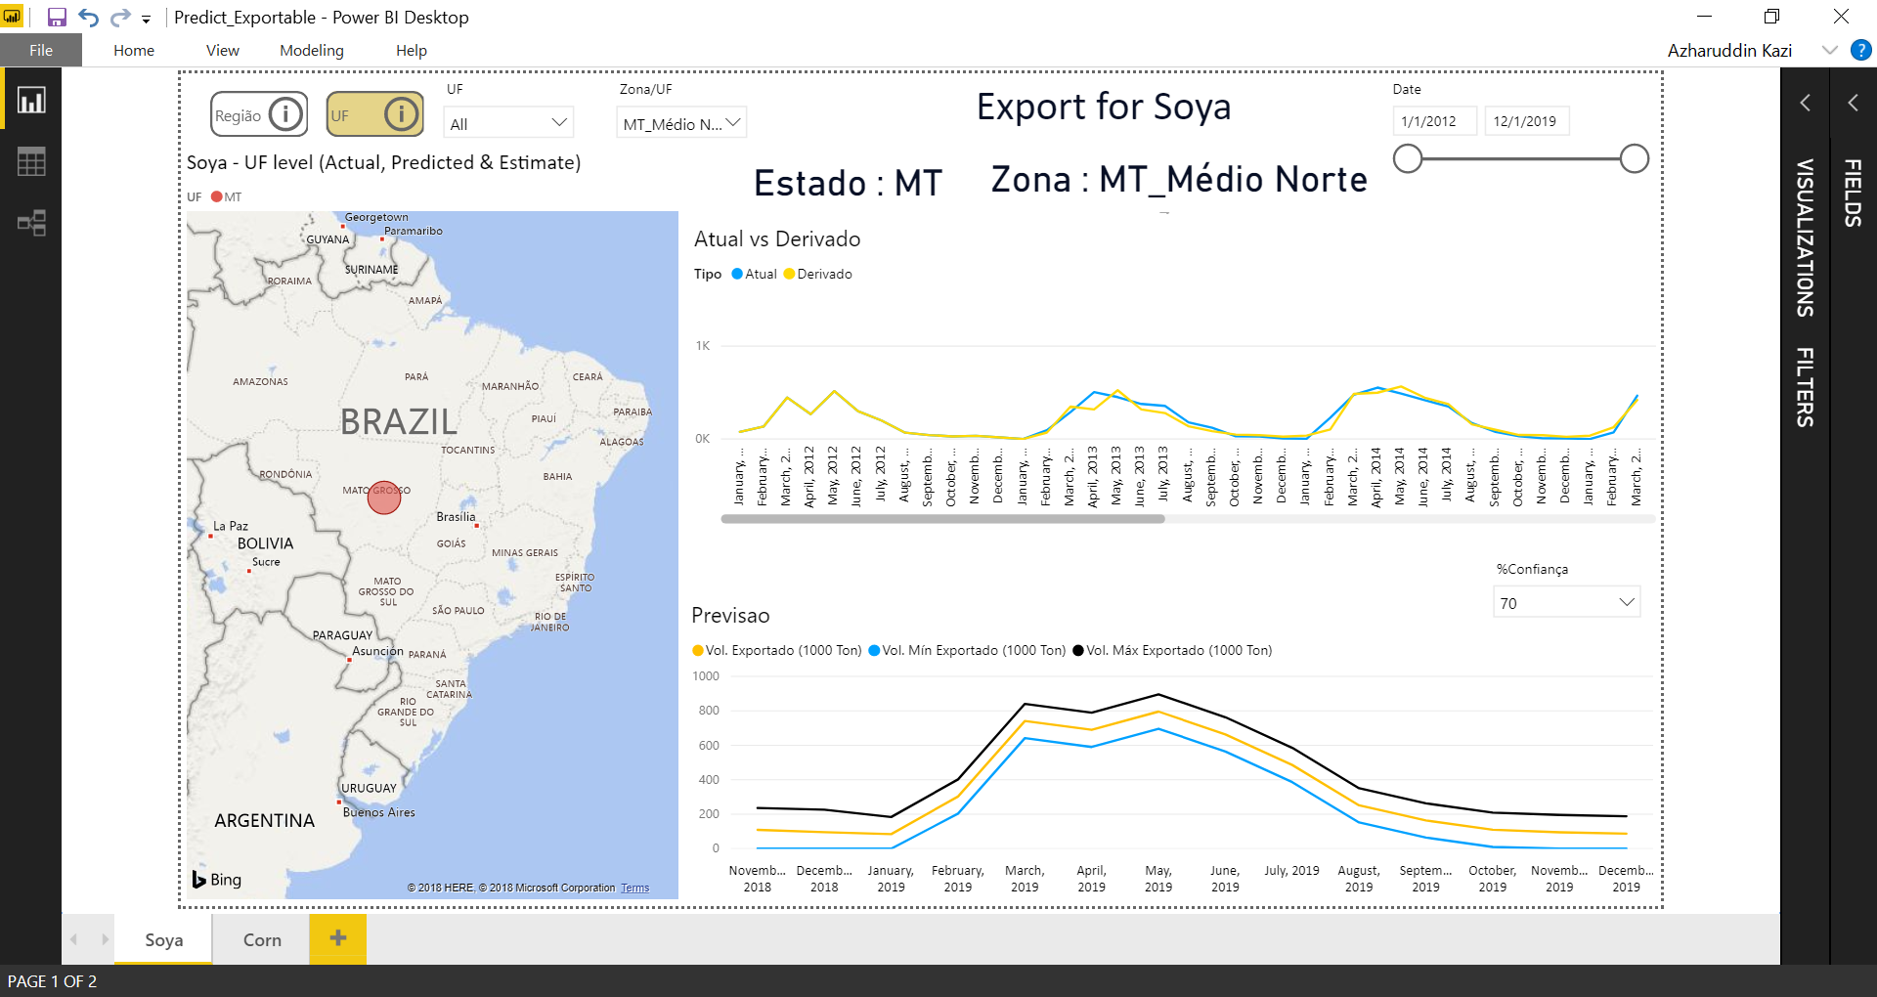

Slide 21
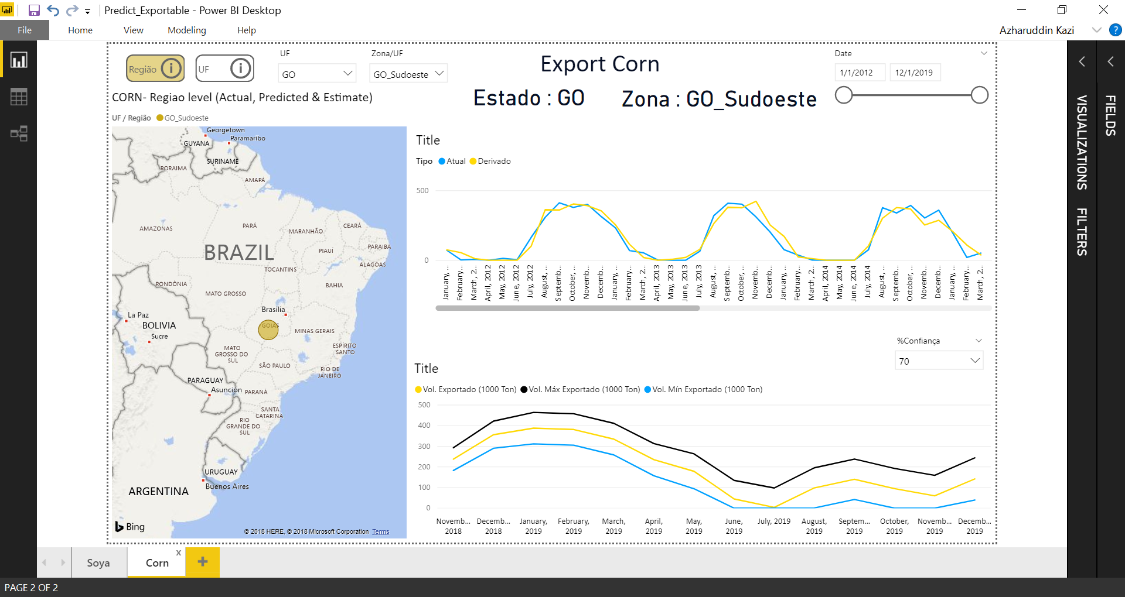

Slide 22
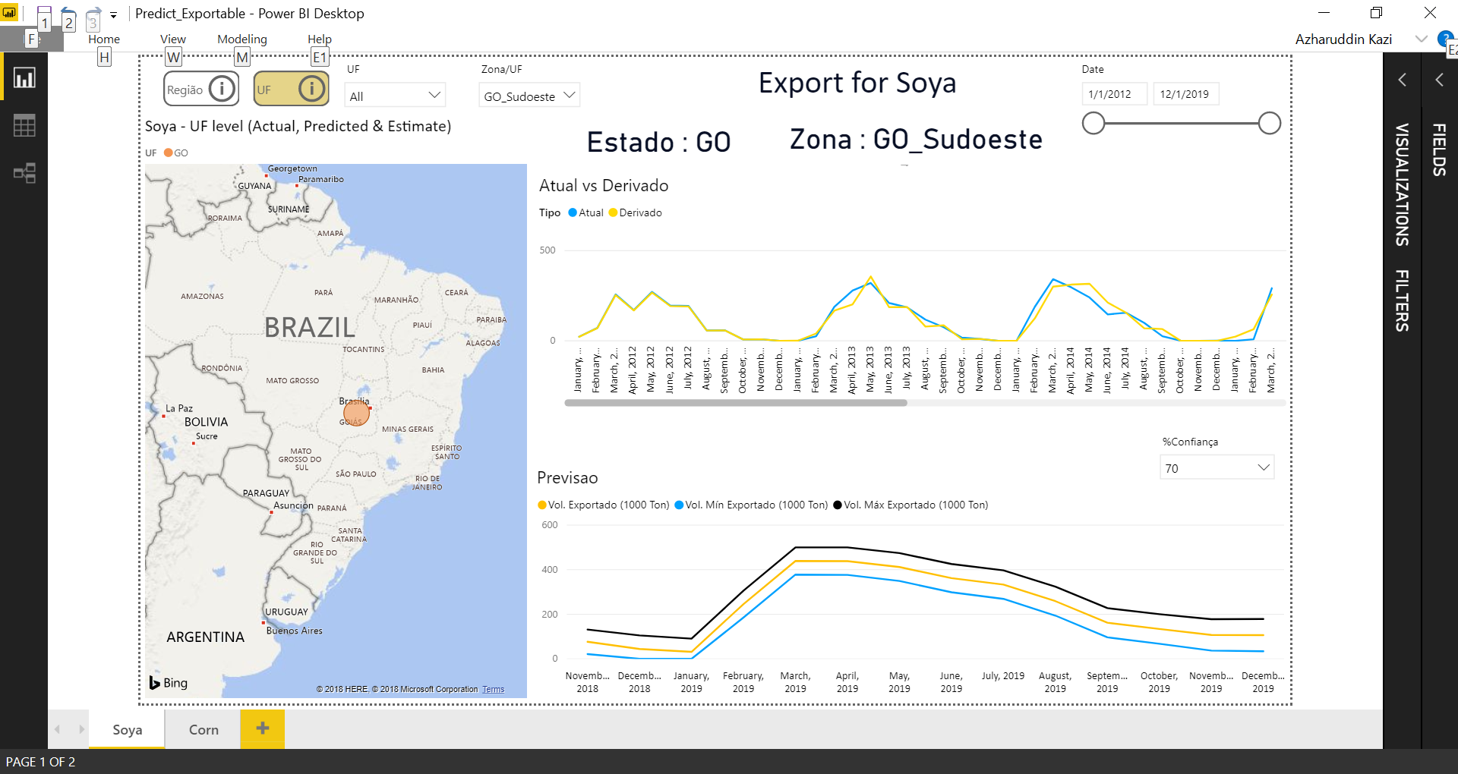

Slide 23
Consumption

Slide 24
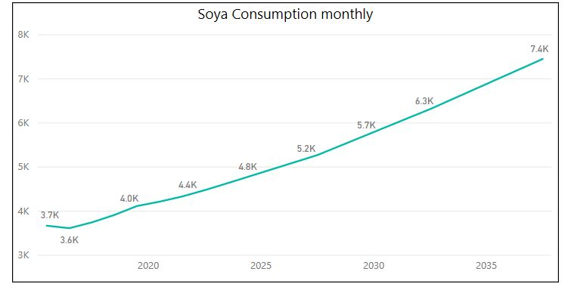
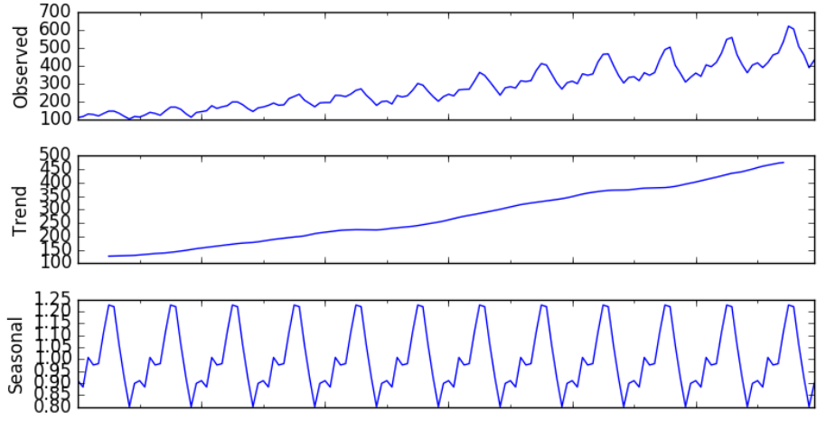
Consumption
Agroconsult actuals and forecasts
Consumption
(Tons)
Brazil – States
Consumption by Year / State
Soja
Milho
Year
Month
State
Zone
Identify impact of co-variates
Trend
Meat Consumption
State wise population growth
Biodiesel Consumption
Income growth per state
Meal and Oil Prices/State
Export Soya and Corn
Co-variates

Slide 25
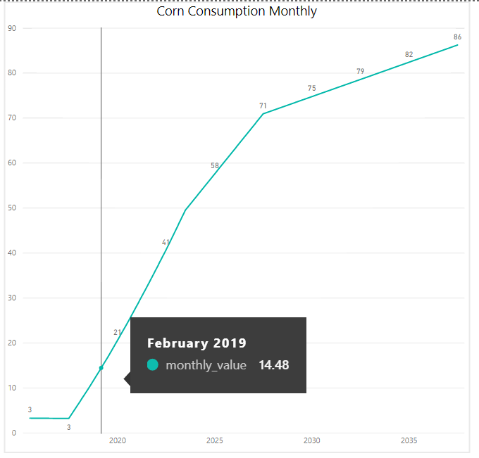
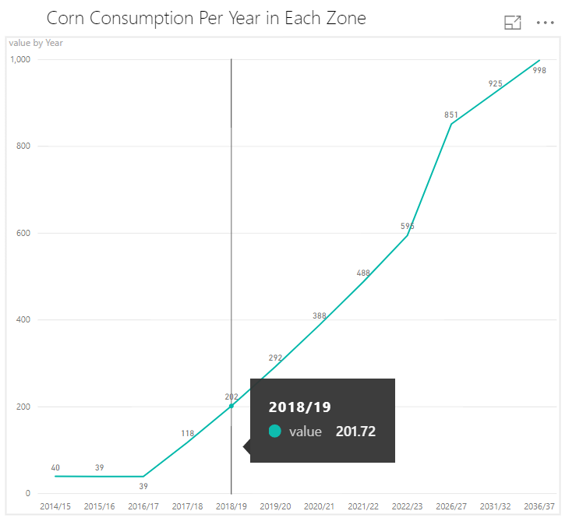
Consumption Ratio Rational
Approach & Solution:
Using Agroconsult data which has Consumption at state and yearly level we divide the yearly values by 12, we use this value as the initial value for June of that year.
Then we difference the values for two consecutive years and divide this number by 12.
We add the fraction calculated above to the initial value for June to arrive at the values the following months.
This approach as agreed with the business experts is better than dividing consumption flat over 12 months

Slide 26
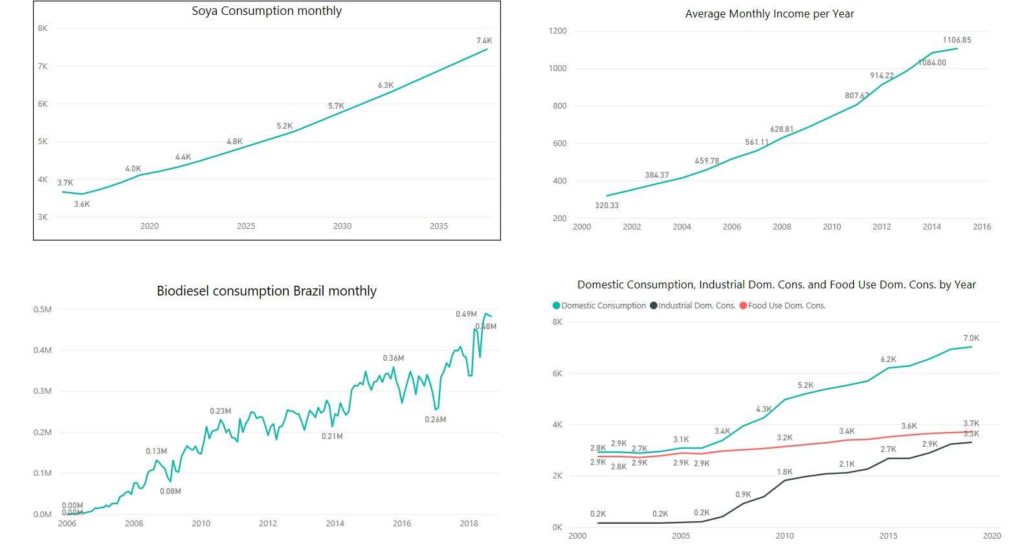
Consumption Covariate Analysis
Linear Regression
(Ridge)
Consumption Monthly
Dependent Variable – Consumption Monthly
~
Independent Variable – Covariates
Co-Variates
Values indicating Significance of Coefficients
Lag Consumption
Population
Income
Exports
Beef consumed
Swine consumed
Chicken consumed
Bio Diesel Consumed
Meal/Oil Prices

Slide 27
Co- Variates Correlations
Observations:
Consumption values of Soya and Corn for a given Year have highest correlation with the past year value of consumption
Meat Consumption is the second highest affecting covariate for consumption of soya and corn
Population growth also has a significant effect on consumption of soya and corn
Biodiesel consumption has a significant impact on consumption of Soya
Income and Exports also have a decent correlation with the values of consumption.
Co-Variates | Coeff
beef_consumed | 5450.307547
chicken_consumed | 5817.803405
population | 5231.89842
income | 5621.752819
swine_consumed | 5758.133924
corn_export | 4894.200107
lag_consum | 5903.774565

Slide 28
Stock and Excess Exportable

Slide 29
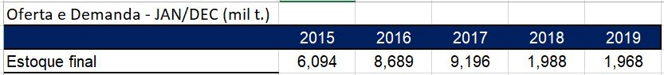
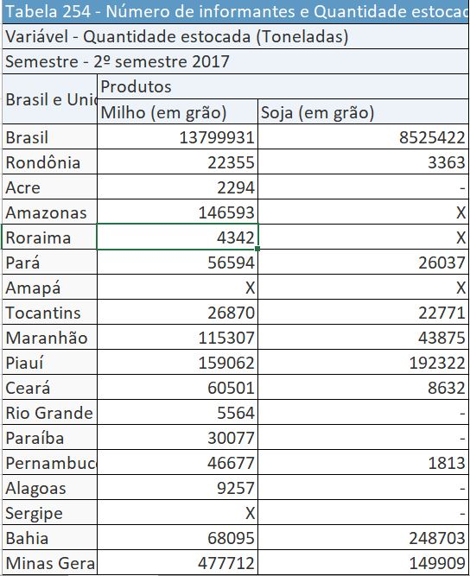
Calculating State and Zone Values from Brazil Level Information for Stock
Since Agroconsult did not have zone wise values for stock, we use IBGE numbers to derive this value
We took % distribution of each zone with respect to the entire country and calculated the fractions for each zone.
We then multiplied these fractions from IBGE with the year end values of stock from Agroconsult to arrive at Zone level stock information
Agro Consult Data
IBGE Data

Slide 30
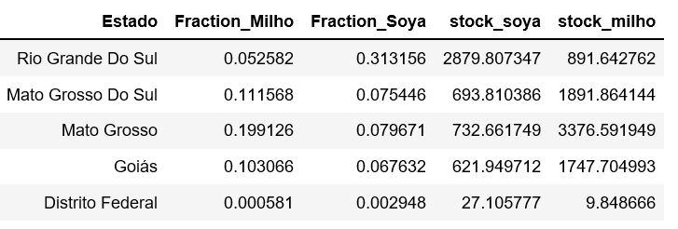
Stock
Agroconsult
Divided Agroconuslt Brazil values into States for the year 2017 using IBGE Percentages
Brazil
Final Stocks - 2017
Initial Stock - 2018
Agroconsult Value – Brazil (1000 Tons) Corn – 16957.0684
Soya – 9196.0758
IBGE
*
Percentage Division State Wise
Brazil + State Wise
Final Stocks -2017

Slide 31

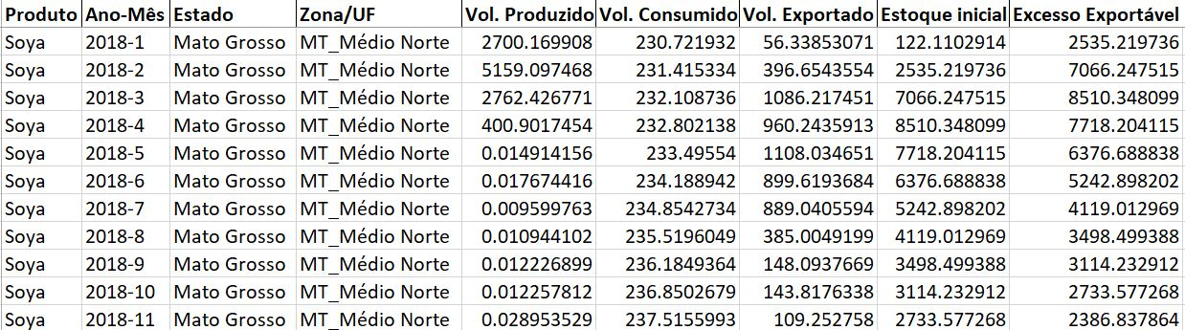
Excess Exportable
Production monthly
Consumption
monthly
Production – Consumption
– Export + Initial Stock
Excess Exportable Monthly
Export monthly
Initial Stock-2018 January

Slide 32
Questions

